Slide 1
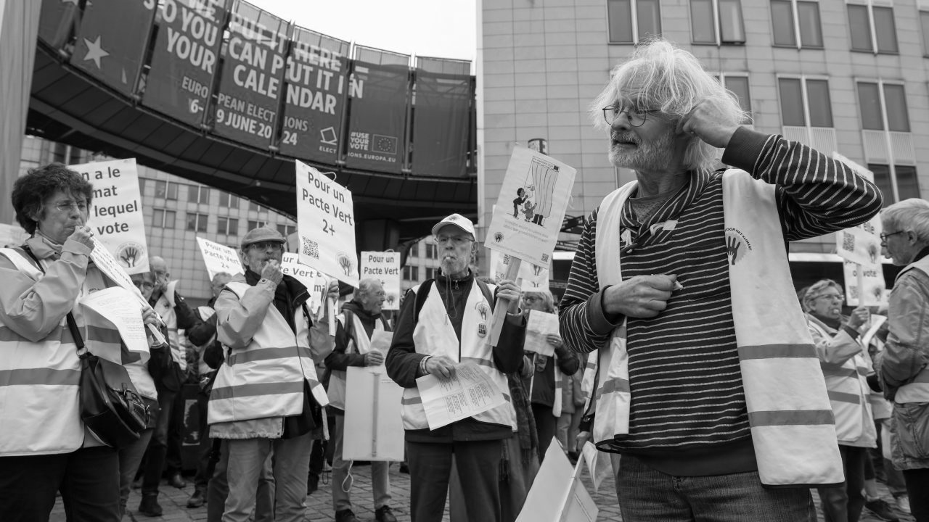

Impact of NGO Campaigns on Bank Stocks
Group 2 Hackathon
Luca Milani, Marta Laskowska, Monika Kaczorowska

Slide 2
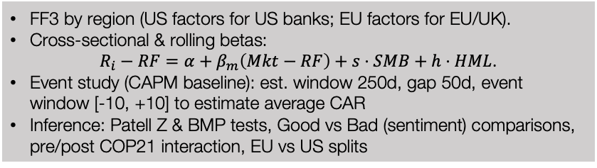
1. Methodologies
Research Question
“Do NGO campaigns influence bank stock performance, and does this effect depend on campaign sentiment or region?”
Data
Models
Daily stock prices and returns for European, UK, US, and Scandinavian banks Fama–French market factors (US & Europe), NGO campaign events from Sigwatch (with sentiment scores).
FF3 by region (US factors for US banks; EU factors for EU/UK). Cross-sectional & rolling betas: $R_{i}−RF=α+β_{m}\left(Mkt−RF\right)+s⋅SMB+h⋅HML$. Event study (CAPM baseline): est. window 250d, gap 50d, event window [-10, +10] to estimate average CAR Inference: Patell Z & BMP tests, Good vs Bad (sentiment) comparisons, pre/post COP21 interaction, EU vs US splits

Slide 3
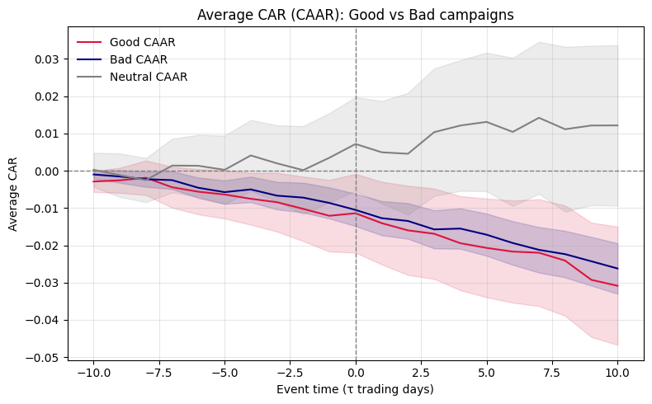
The Motivation
2. Findings
Main takeaways
Negative stock reaction: average CAAR around NGO is −2.5% over ±10 days. Sentiment neutrality: both “good” and “bad” campaigns lead to declines of similar size Regional contrast: effect is stronger and more consistent in Europe Statistical support: drop in stock prices is statistically significant, not random No structural break: no meaningful change in reactions after COP21

Slide 4
The data
3. Next steps
Limitations
Possible improvements
Imbalanced sentiment data: dataset contains many more “bad” than “good” campaigns Event timing issues: some NGO campaign dates had to be snapped to nearby trading days Matching uncertainty: company name mismatches and limited overlap between Sigwatch and bank data Model simplifications: used CAPM/FF3 without accounting for other factors (size, momentum, macro shocks); assumes independent events and no cross-event contagion.
Enrich event data: collect additional information from social media or news sources to capture campaign visibility and reach. Improve sentiment quality: reassess or refine Sigwatch’s sentiment analysis Expand the factor model: use the Fama–French 5-Factor (FF5) model Test multiple event windows: add alternative CAR estimation horizons to check robustness. Broaden geographic scope: extend the sample globally beyond the US and EU

